Slide 1
Central Data Exchange Demo
Storyboard

Slide 2
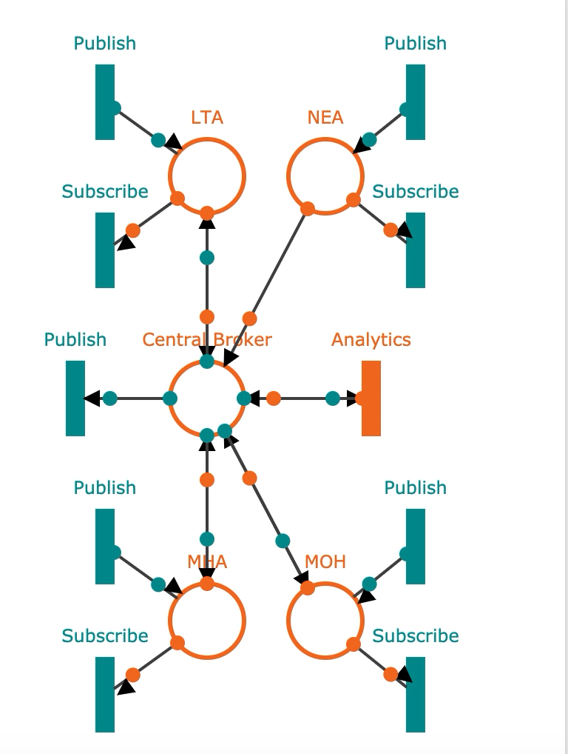
Example Broker Set-up

Slide 3
Overall Site Diagram
Login Page
Homepage
Register
Admin
Analytics & Mapping
Available
Topics
Analytics & Mapping
Dataflow
Graph
Published
Topics
Message
Logs
Register
Agency
Notes:
Polyglot, Open API Ecosystem

Slide 4
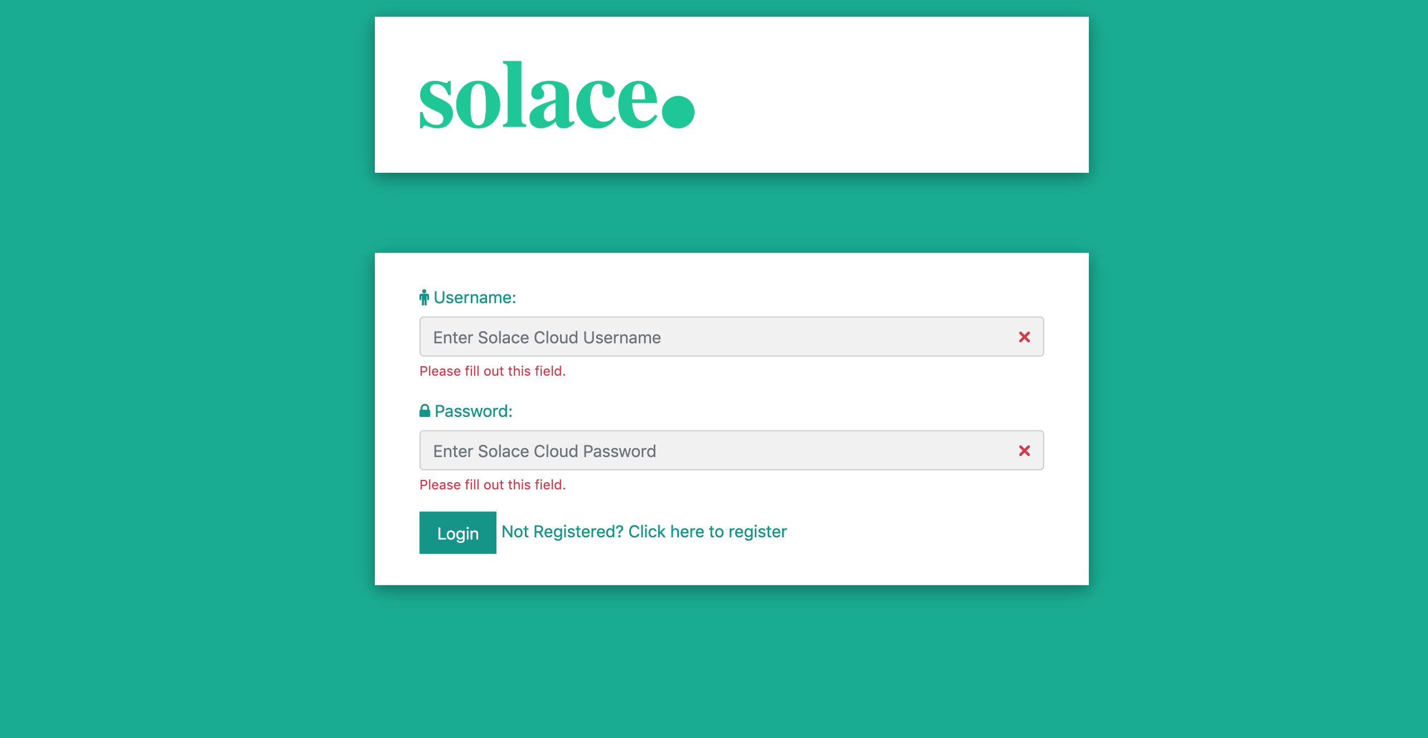
Log-in Page
First page to start from when running the demo
Page to access the central broker and view topics available to be used
New agencies can access the registration page from here

Slide 5
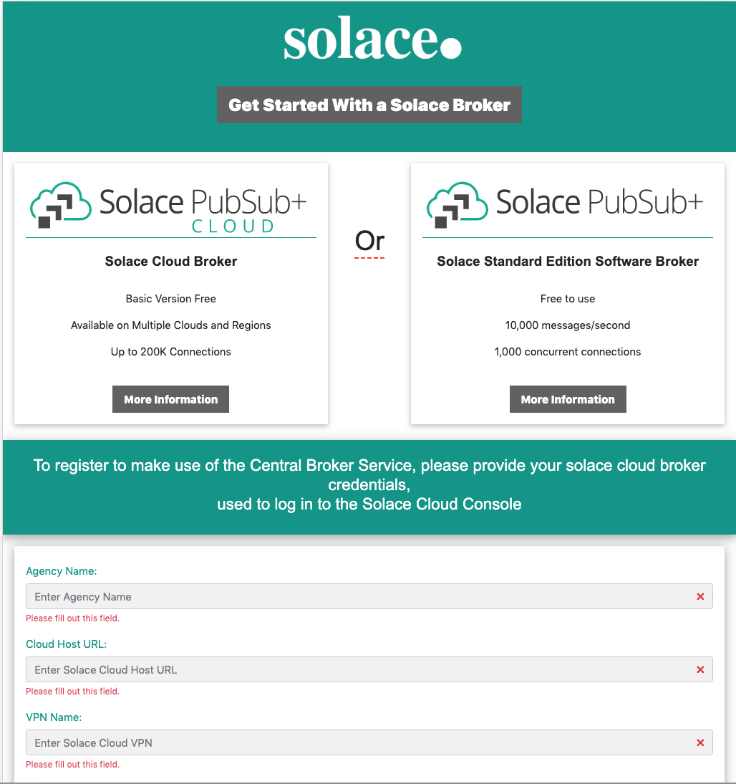
Registration Page
Information on broker available here
New Agencies can provide their solace broker details to request to be connected to the central broker
Solace broker details will be used by the central broker administrator to establish a new bridge

Slide 6
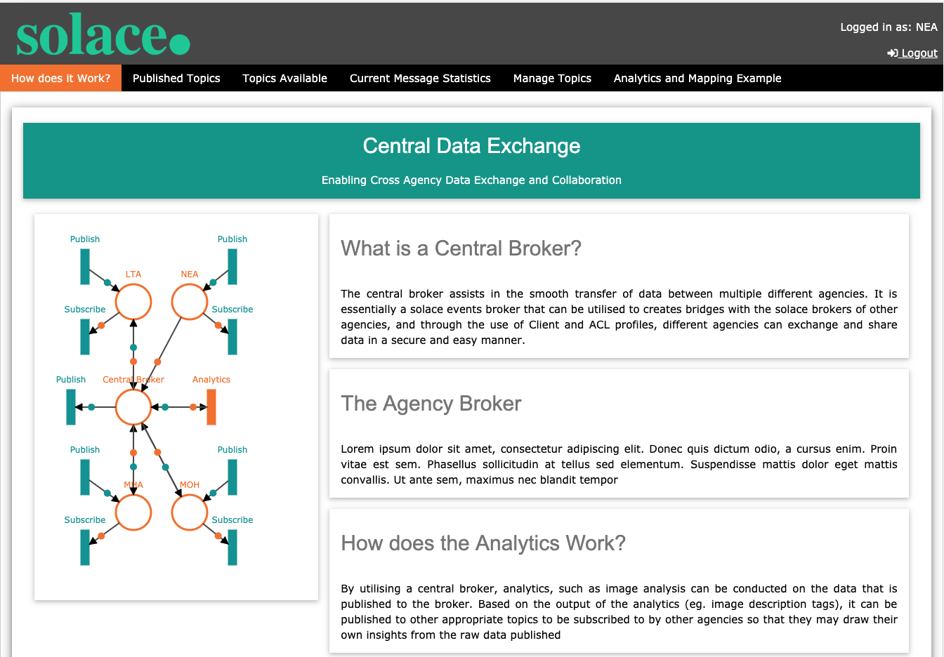
Home Page
After logging on using a username registered on the ACL this the page that users will be led to
Provides brief description about the exchange and its features
Other tabs can be accessed from the navbar

Slide 7
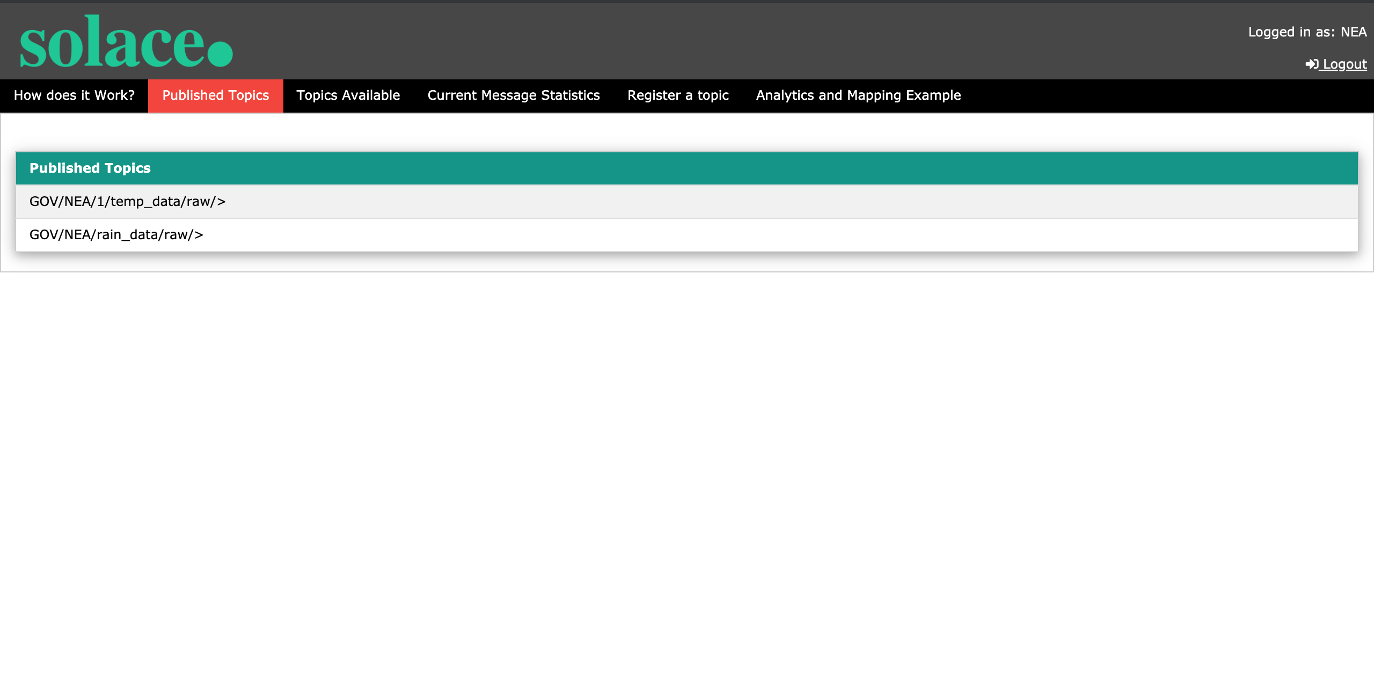
Home Page – Published Topic
Utilises an Access Control List (ACL) to populate all Topics that the agency is publishing to the central broker

Slide 8
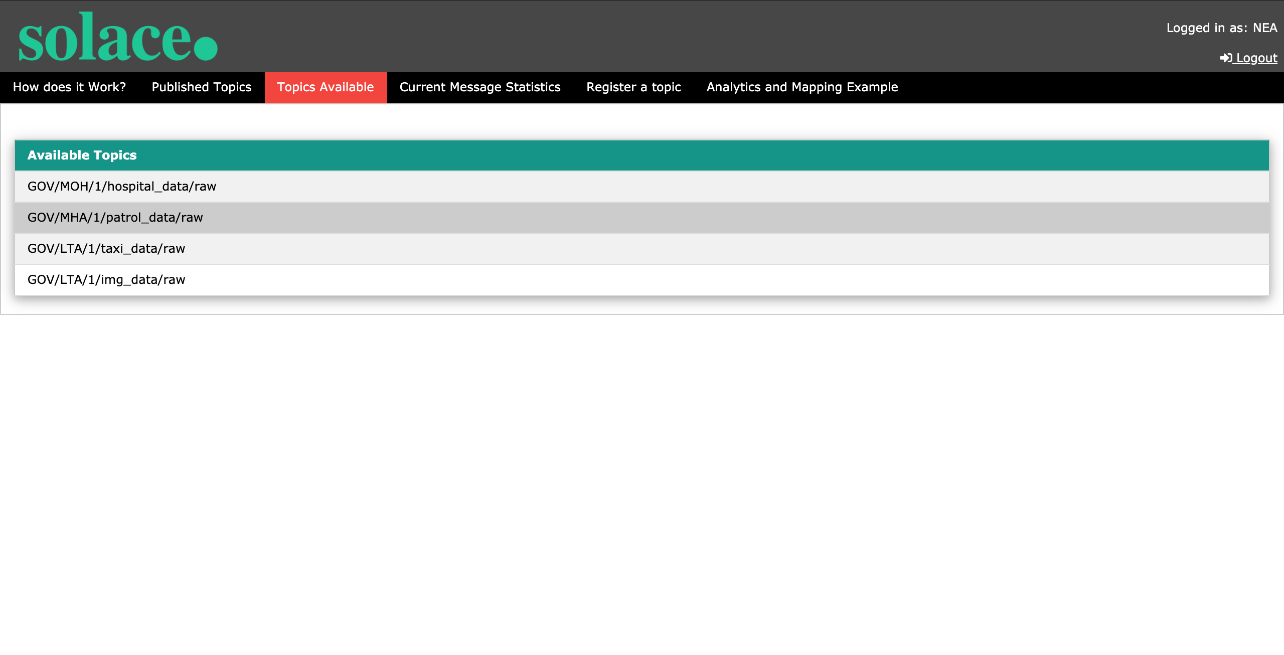
Home Page – Topics Available
Utilises an Access Control List (ACL) to populate all Topics that are available for the agency to subscribe to via the central broker

Slide 9
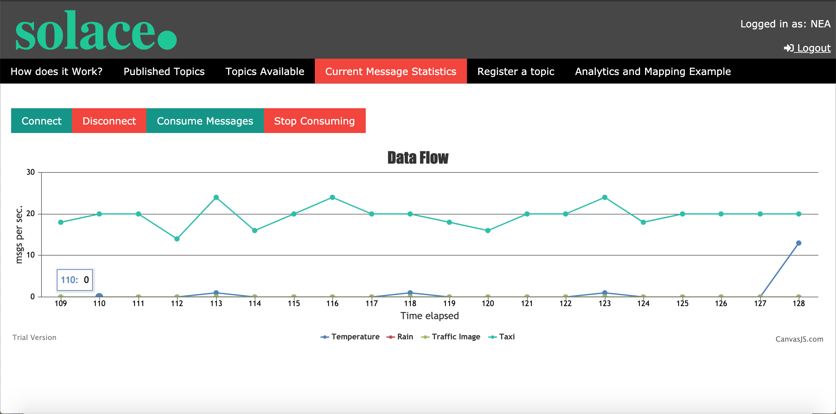
Home Page – Current Message Statistics
Provides an overall view of the message flow rate from various topics that the agency is subscribed or publishing to

Slide 10
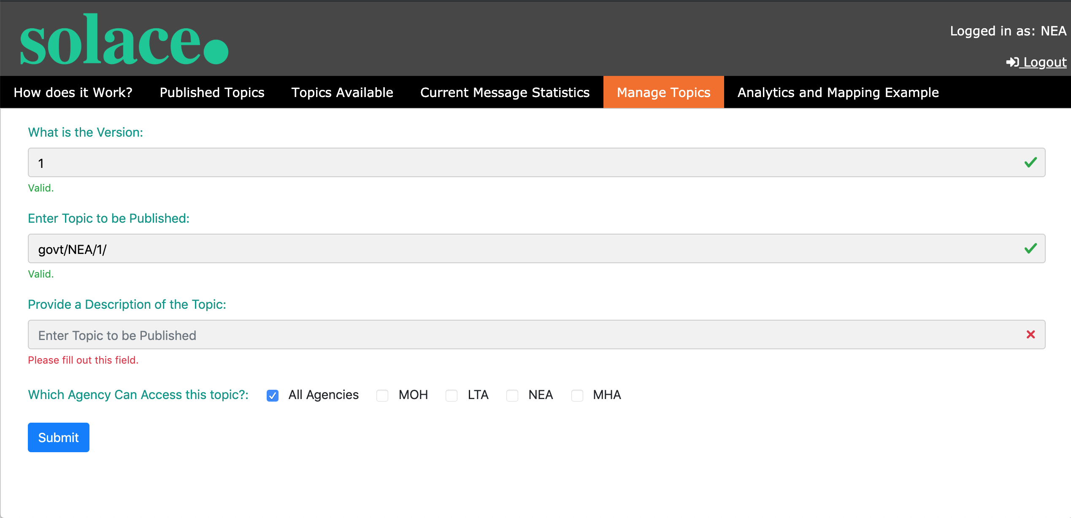
Home Page – Topic Registration
User can register new topics that they wish to share on the central broker
Access control as to which agencies can access these topics, can also be indicated

Slide 11
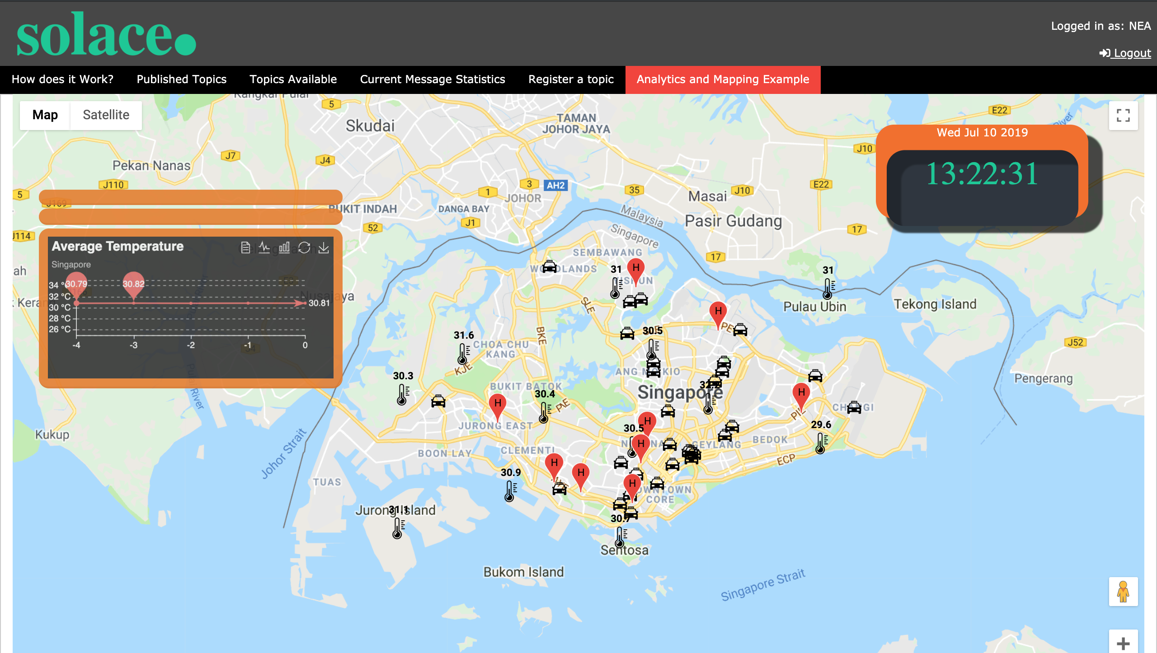
Home Page – Analytics & Mapping Example
Provides an example of various data streams consumed from different agencies and geospatially maps it
Raw image data is also processed through a image analysis and based on the output, is further to other subtopics

Slide 12
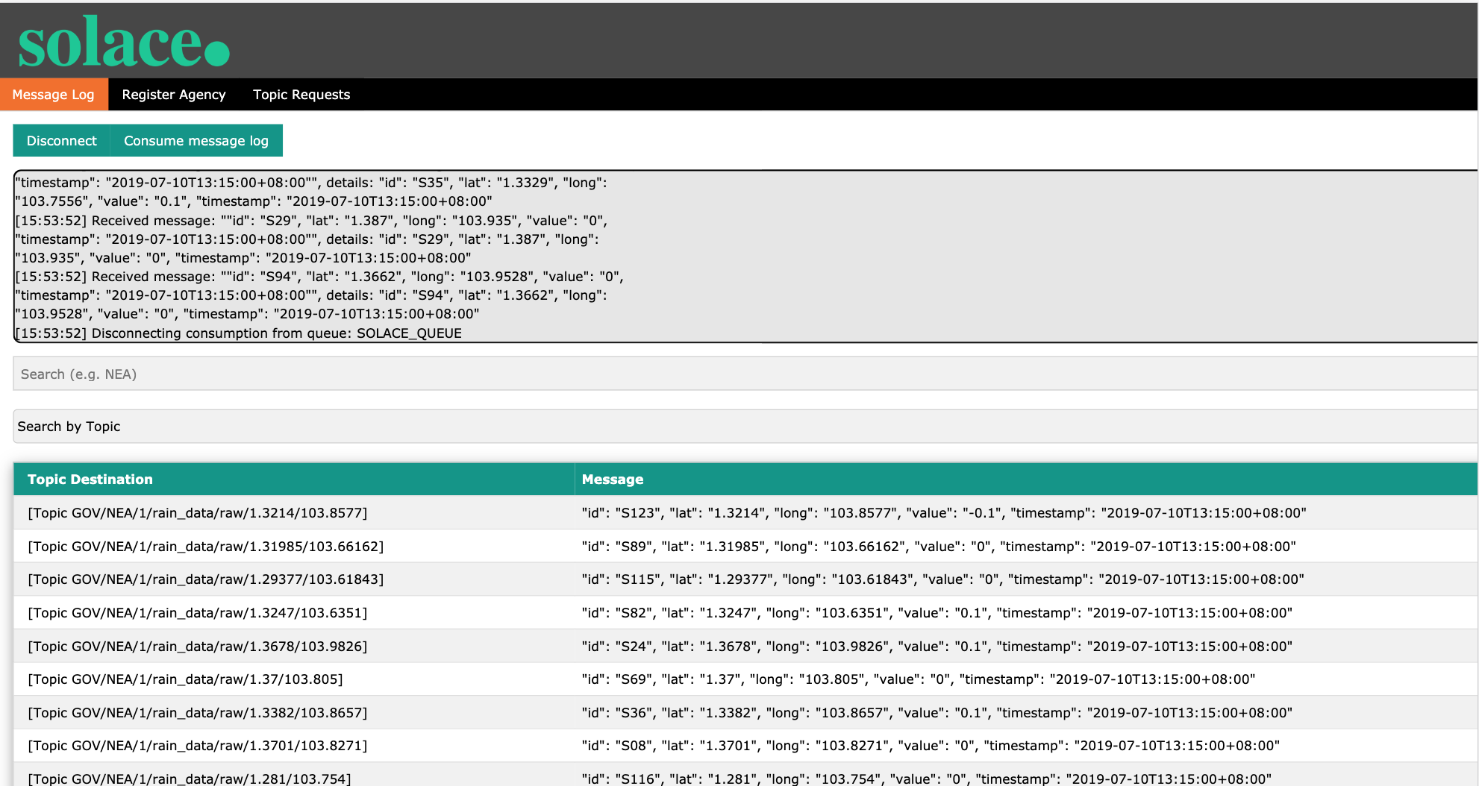
Message Log
This view is accessed by login in via the login console using username: admin password: pass
User can view a complete log of all messages published and further search based on key words or individuals

Slide 13
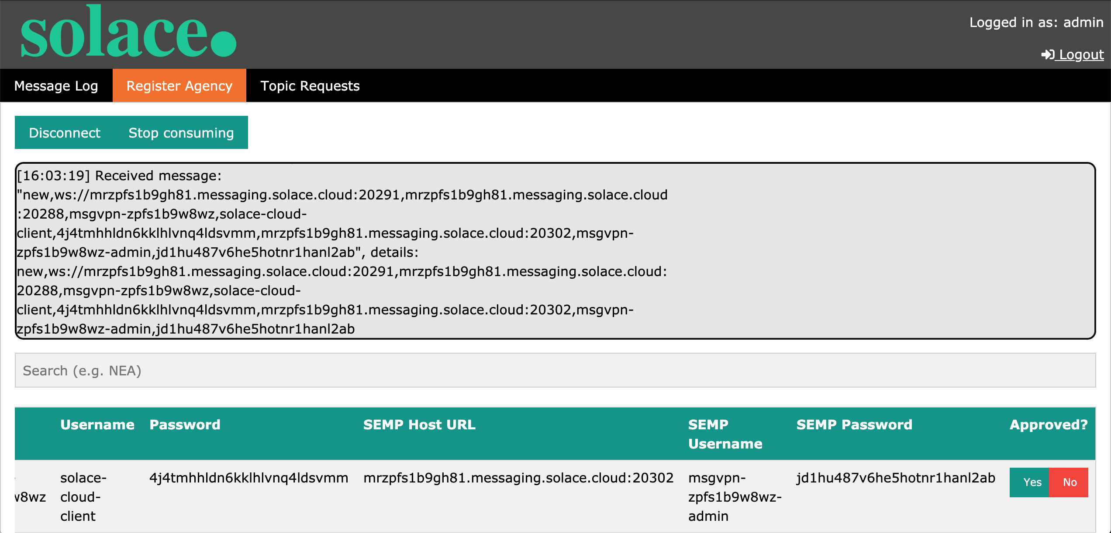
Register Agency
This view is accessed by login in via the login console using username: admin password: pass
User can view the registration information provided by the agencies and further utilize it to create a bridge between the agencies broker and the central broker
Clicking yes will trigger the SEMP call and create a bridge from the central broker to the agency broker using the information provided

Slide 14
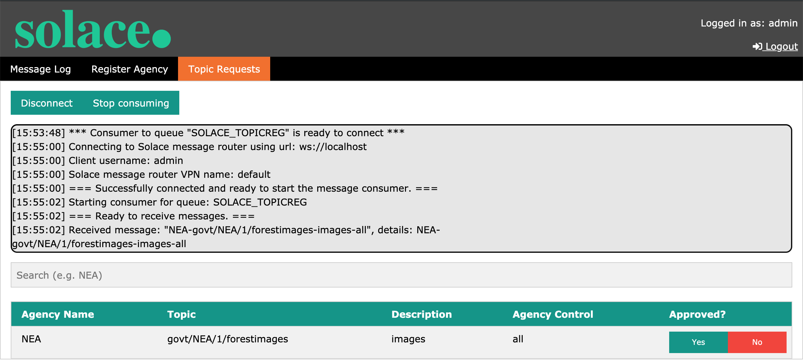
Register Topic
This view is accessed by login in via the login console using username: admin password: pass
Administrator can view the Topic information provided by the agencies and subsequently approve or deny the agency to start publishing to the topic on the central broker
Upon clicking yes a SEMP call is triggered to create the topic in the relevant ACLs

